Slide 1
Chapter 2 Application Layer
Notes:
Version History
8.1. Updates throughout, including a lot more animations. These are the ppt files used to make Chapter 2 online lectures in Sept. 2020.
8.0 (April 2020)
All slides reformatted for 16:9 aspect ratio
All slides updated to 8th edition material
Use of Calibri font, rather that Gill Sans MT
Add LOTS more animation throughout

Slide 2
Application layer: overview
Principles of network applications
Web and HTTP

Slide 3
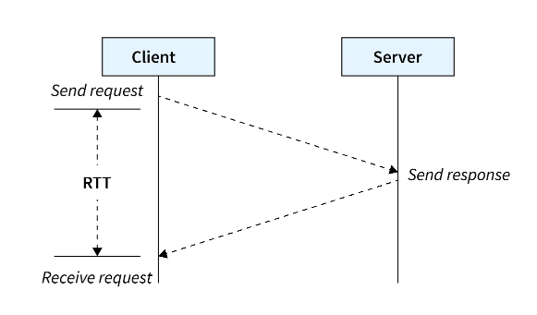
HTTP connections: Pre-requisite
Round Trip Time (RTT)
Round Trip Time is defined as the time taken by a packet of information to travel from client to server and then come back (i.e. server to client).

Slide 4
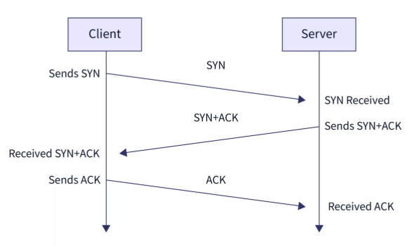
HTTP connections: Pre-requisite
TCP 3-Way Handshake
The establishment of a TCP connection takes place in 3 steps which are referred to as 3-Way Handshake.

Slide 5
HTTP connections: two types
Non-persistent
Without Parallel Connection
With Parallel Connection
Persistent
Non-pipelined
Pipelined

Slide 6
HTTP connections: Non-persistent
In non-persistent HTTP connections, at most one object can be sent over a single TCP connection.
For each object to be sent from source to destination, a new TCP connection is created.
HTTP/1.0 uses non-persistent connections.
Non-persistent connection HTTP requires 2 RTT (round trip time) for each object that is to be transmitted (1 RTT to open the connection and 1 RTT for transmission of data).

Slide 7
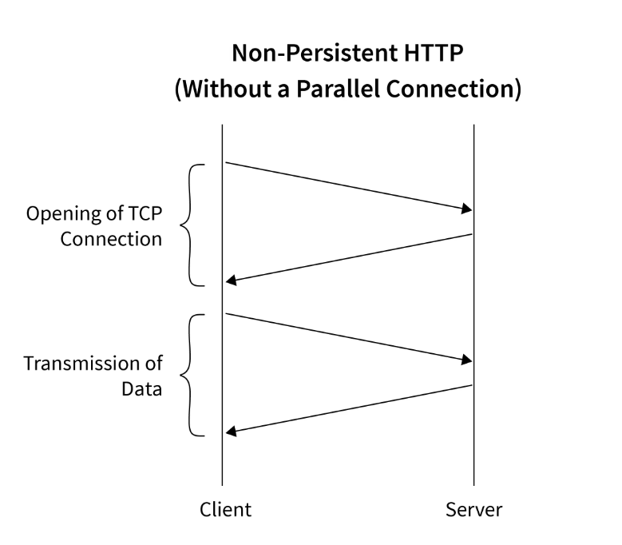
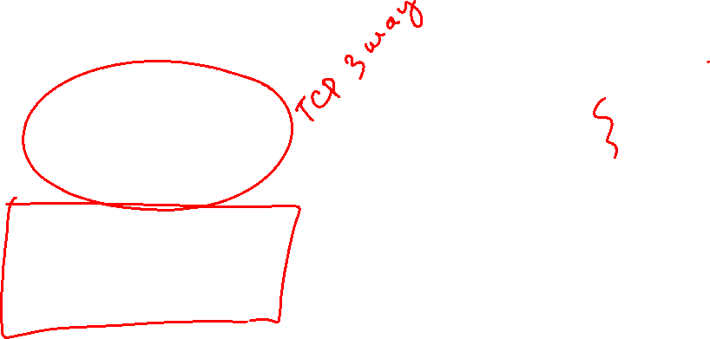
HTTP connections: Non-persistent

Slide 8
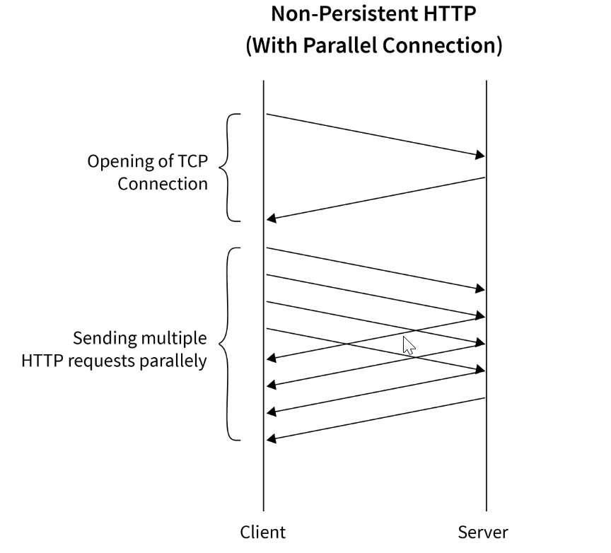
HTTP connections: Non-persistent

Slide 9
HTTP connections: Non-persistent
Advantages of Non-Persistent HTTP:
Uses resources efficiently; connection opens only when needed.
More secure; connection closes after data transfer.
Disadvantages of Non-Persistent HTTP:
Extra overhead to open a TCP connection each time.
Slower start due to repeated connection setup.

Slide 10
HTTP connections: Persistent
Multiple objects can be sent over a single TCP connection.
Allows multiple objects to be transmitted from source to destination without opening a new connection for each object.
HTTP/1.1 is the version of HTTP that uses persistent connections by default.
All modern web browsers (e.g., Mozilla Firefox, Google Chrome) use persistent HTTP connections.
Persistent HTTP does not require 2 RTTs per object.
After the TCP connection is successfully opened (via 3-way handshake, which takes 1 RTT), each object requires only 1 RTT to be transmitted.

Slide 11
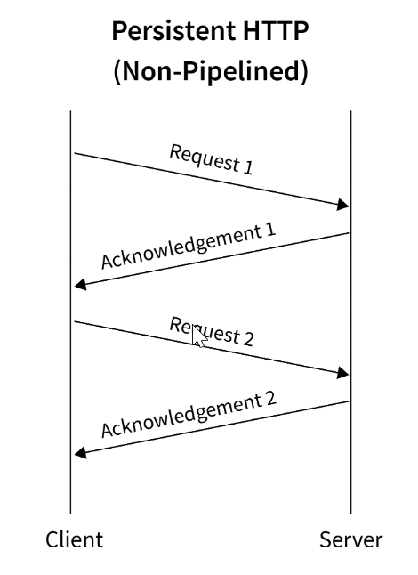
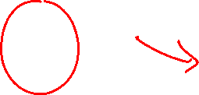
HTTP connections: Persistent

Slide 12
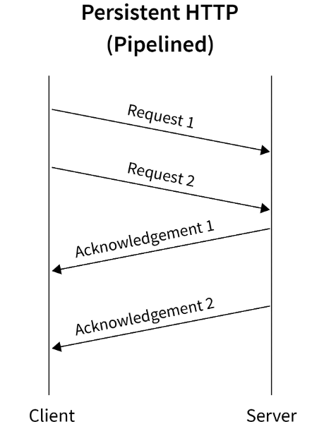

HTTP connections: Persistent

Slide 13
HTTP connections: Persistent
Advantages of Persistent HTTP:
Saves CPU and time by opening the connection only once.
Faster transmission of objects.
Reduces network congestion and latency on subsequent requests.
Disadvantages of Persistent HTTP:
Wastes network resources when idle.
Less secure, as the connection remains open.

Slide 14

HTTP connections: two types
Non-persistent HTTP
TCP connection opened
at most one object sent over TCP connection
TCP connection closed
downloading multiple objects required multiple connections
Persistent HTTP
TCP connection opened to a server
multiple objects can be sent over single TCP connection between client, and that server
TCP connection closed

Slide 15


Non-persistent HTTP: example
User enters URL:
www.someSchool.edu/someDepartment/home.index
(containing text, references to 10 jpeg images)
1a. HTTP client initiates TCP connection to HTTP server (process) at www.someSchool.edu on port 80
1b. HTTP server at host www.someSchool.edu waiting for TCP connection at port 80 “accepts” connection, notifying client
2. HTTP client sends HTTP request message (containing URL) into TCP connection socket. Message indicates that client wants object someDepartment/home.index
3. HTTP server receives request message, forms response message containing requested object, and sends message into its socket
time

Slide 16

Non-persistent HTTP: example (cont.)
User enters URL:
www.someSchool.edu/someDepartment/home.index
(containing text, references to 10 jpeg images)
4. HTTP server closes TCP connection.
5. HTTP client receives response message containing html file, displays html. Parsing html file, finds 10 referenced jpeg objects
6. Steps 1-5 repeated for each of 10 jpeg objects
time

Slide 17

Non-persistent HTTP: response time
RTT (definition): time for a small packet to travel from client to server and back
HTTP response time (per object):
one RTT to initiate TCP connection
one RTT for HTTP request and first few bytes of HTTP response to return
object/file transmission time
initiate TCP
connection
RTT
request file
RTT
time to
transmit
file
file received
time
time
Non-persistent HTTP response time = 2RTT+ file transmission time

Slide 18
Persistent HTTP (HTTP 1.1)
Non-persistent HTTP issues:
requires 2 RTTs per object
OS overhead for each TCP connection
browsers often open multiple parallel TCP connections to fetch referenced objects in parallel
Persistent HTTP (HTTP1.1):
server leaves connection open after sending response
subsequent HTTP messages between same client/server sent over open connection
client sends requests as soon as it encounters a referenced object
as little as one RTT for all the referenced objects (cutting response time in half)

Slide 19
Pipelining
Issue multiple requests at a time
Don’t have to wait for previous response
More efficient use of link
Use carefully
POST requests should not be pipelined (changes server state)
GET/HEAD requests are usually okay
Notes:
Can put several requests in a single packet

Slide 20
Persistent HTTP
Non-persistent HTTP issues:
Connection setup for each request
But browsers often open parallel connections
Persistent HTTP:
Server leaves connection open after sending response
Subsequent HTTP messages between same client/server are sent over connection
Persistent without pipelining:
Client issues new request only when previous response has been received
One RTT for each object
Persistent with pipelining:
Default in HTTP/1.1 spec
Client sends multiple requests
As little as one RTT for all the referenced objects
Server must handle responses in same order as requests

Slide 21
“Persistent without pipelining” most common
When does pipelining work best?
Small objects, equal time to serve each object
Small because pipelining simply removes additional RTT delay to request new content
Notes:
Head-of-line blocking: if big item is the first request, smaller requests are stuck waiting behind it to finish when they could be issued as a parallel connection

Slide 22
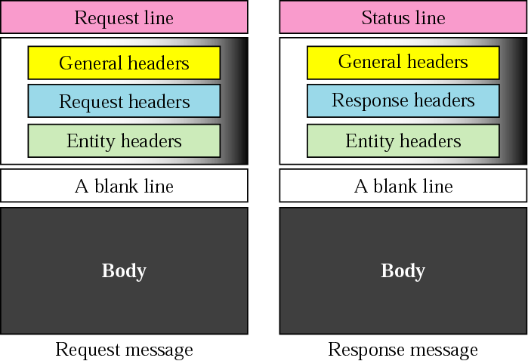

HTTP protocol – message format
two types of messages: request & response
ASCII (human-readable format)

Slide 23
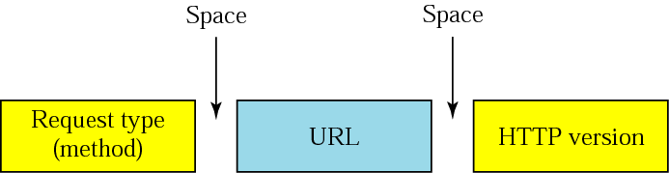
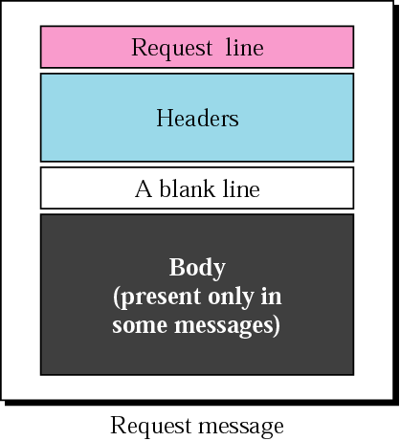
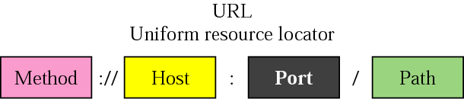
HTTP protocol – message format
HTTP request message
HTTP 0.9 HTTP 1.0 HTTP 1.1
GET – when the client wants to retrieve a document from the server
HEAD – when the client wants some info about a document but not document itself
COPY – copies the file to another location

Slide 24
Method Types
HTTP/1.0:
GET
POST
HEAD
asks server to leave requested object out of response
i.e. request info about a doc
HTTP/1.1:
GET, POST, HEAD
PUT
uploads file in entity body to path specified in URL field
DELETE
deletes file specified in the URL field

Slide 25
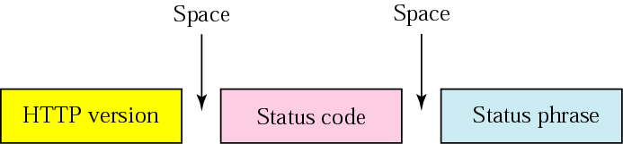
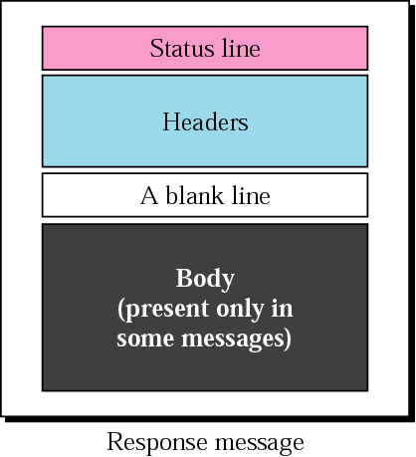
HTTP protocol – message format
http://www.w3.org/Protocols/HTTP/HTRESP.html
HTTP response message
explains the status code
in text form
200 OK – request succeeded
301 Moved Permanently – object moved
400 Bad Request – not understood by server
404 Not Found – req. document not found

Slide 26
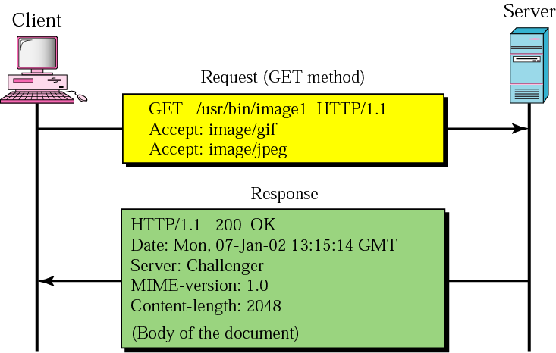
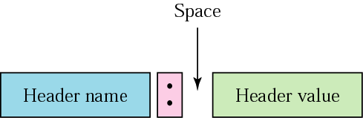

HTTP messages – an example
This example retrieves a document.
We use the GET method to retrieve an image with the path/usr/bin/image1.
The request line shows the method (GET), the URL, and the HTTP version (1.1).
The header has two lines that show that the client can accept images in GIF and JPEG format.

Slide 27
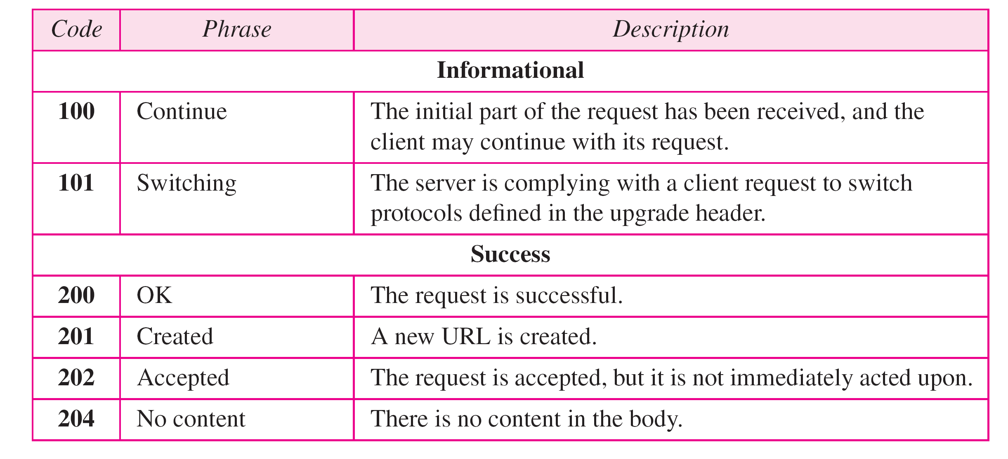
HTTP response status codes
status code appears in 1st line in server-to-client response message.
some sample codes:

Slide 28
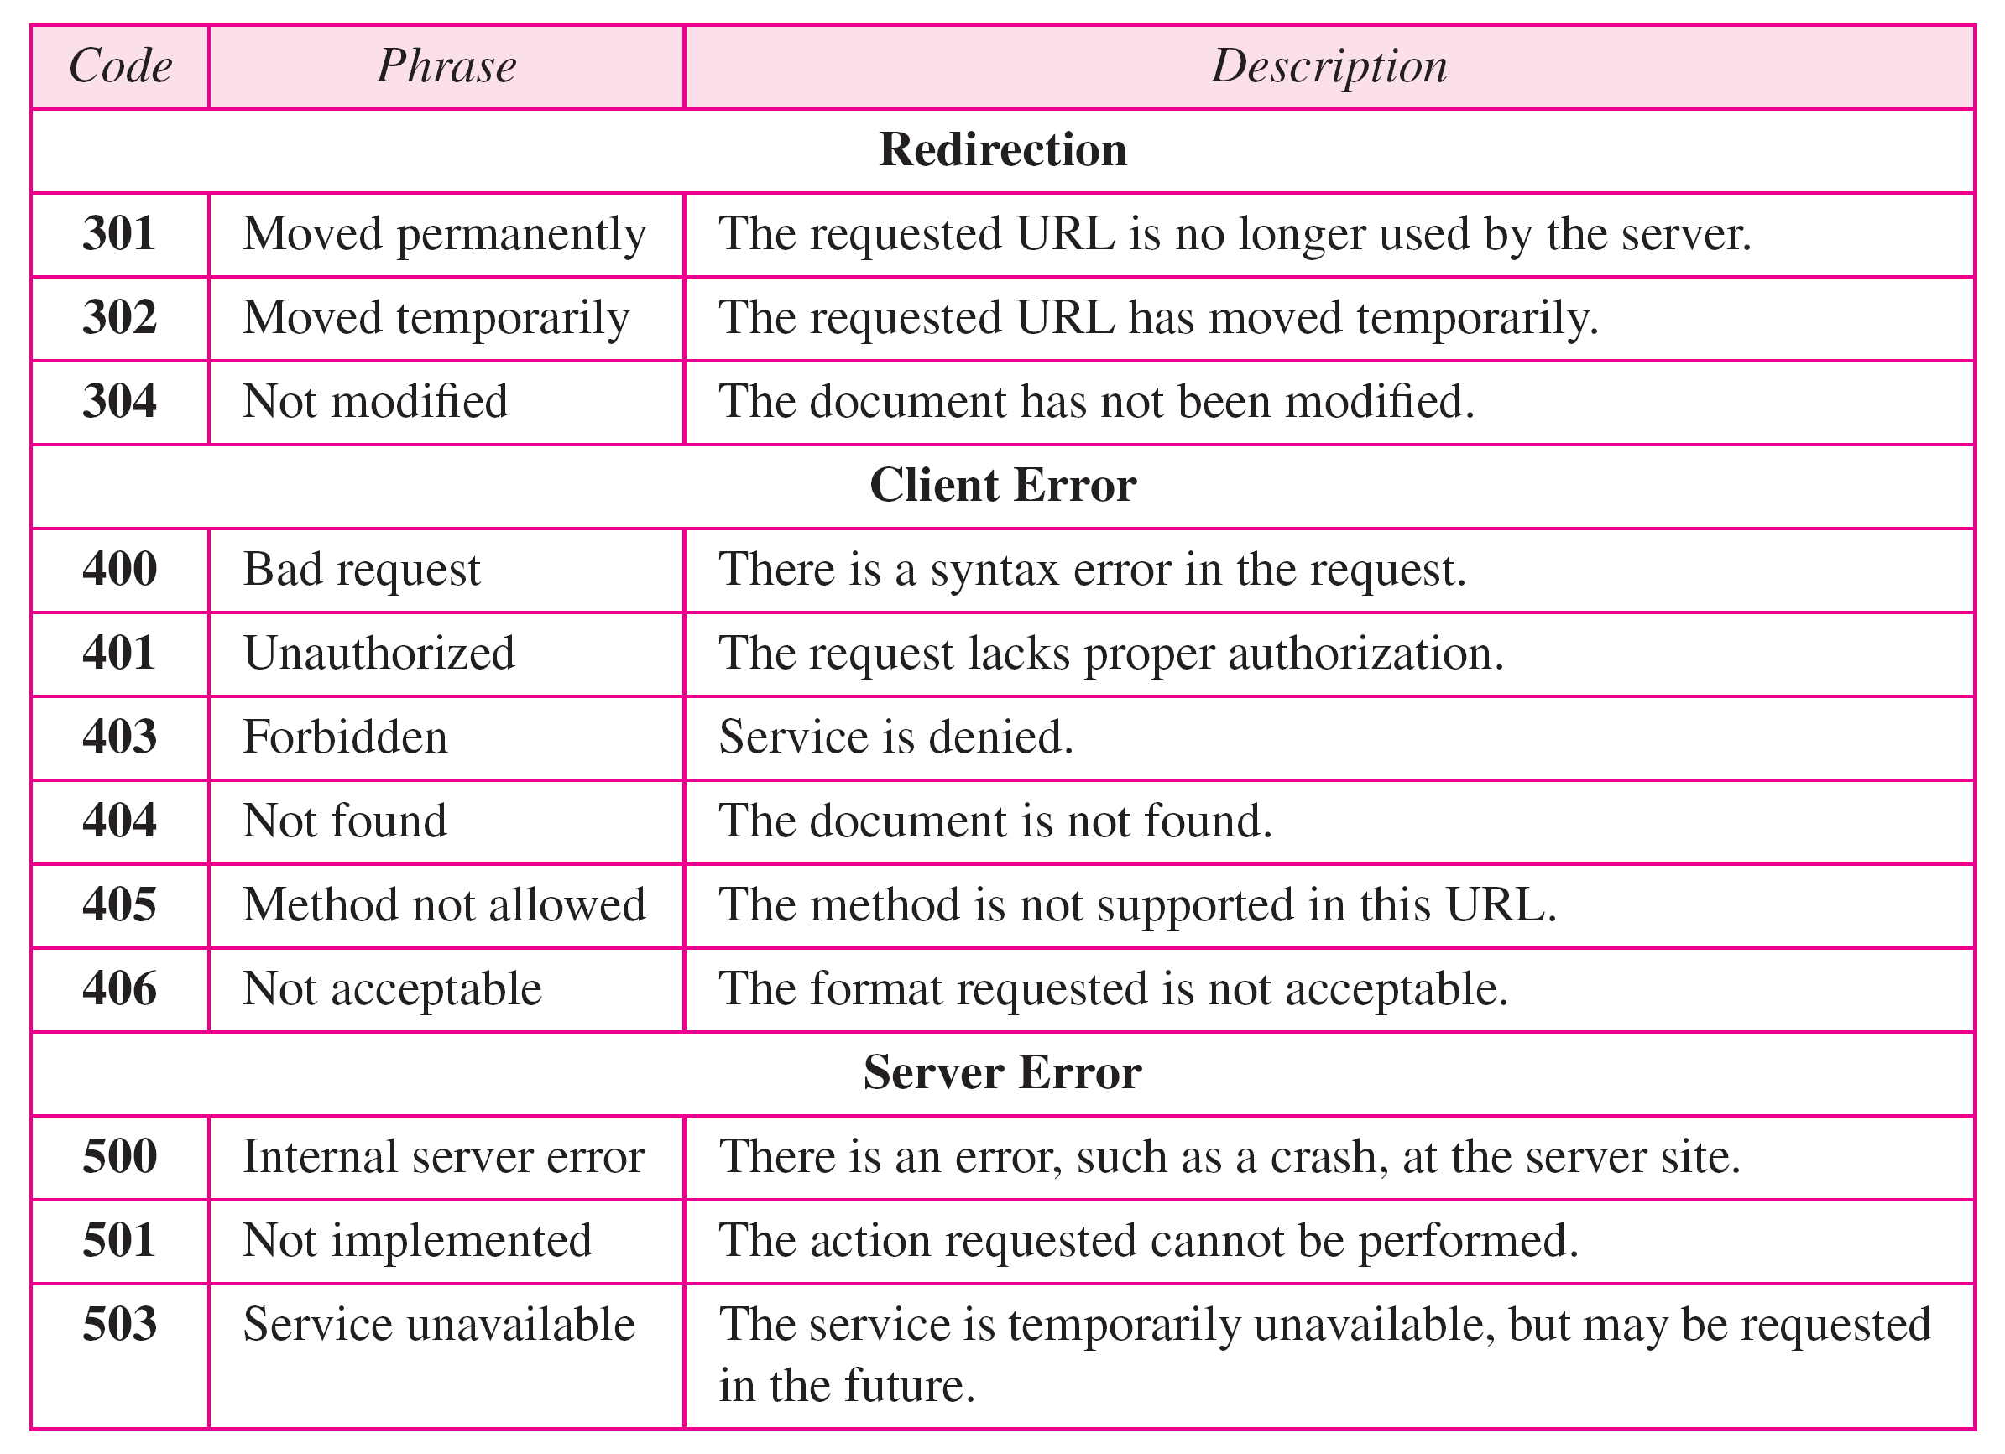

HTTP response status codes

Slide 29
Other HTTP request messages
POST method:
web page often includes form input
user input sent from client to server in entity body of HTTP POST request message
HEAD method:
requests headers (only) that would be returned if specified URL were requested with an HTTP GET method.
PUT method:
uploads new file (object) to server
completely replaces file that exists at specified URL with content in entity body of POST HTTP request message
GET method (for sending data to server):
include user data in URL field of HTTP GET request message (following a ‘?’):
www.somesite.com/animalsearch?monkeys&banana

Slide 30
Trying out HTTP (client side) for yourself
1. netcat to your favorite Web server:
% nc -c -v gaia.cs.umass.edu 80 (for Mac)
>ncat –C gaia.cs.umass.edu 80 (for Windows)
opens TCP connection to port 80 (default HTTP server port) at gaia.cs.umass.edu.
anything typed in will be sent to port 80 at gaia.cs.umass.edu
2. type in a GET HTTP request:
GET /kurose_ross/interactive/index.php HTTP/1.1
Host: gaia.cs.umass.edu
by typing this in (hit carriage return twice), you send this minimal (but complete) GET request to HTTP server
3. look at response message sent by HTTP server!
(or use Wireshark to look at captured HTTP request/response)

Slide 31

Maintaining user/server state: cookies
Recall: HTTP GET/response interaction is stateless
no notion of multi-step exchanges of HTTP messages to complete a Web “transaction”
no need for client/server to track “state” of multi-step exchange
all HTTP requests are independent of each other
no need for client/server to “recover” from a partially-completed-but-never-completely-completed transaction
a stateful protocol: client makes two changes to X, or none at all
X
lock data record X
X
OK
update X X’
X’
OK
t’
update X X’’
OK
X’’
unlock X
OK
X’’
time
time
Q: what happens if network connection or client crashes at t’ ?
Notes:
t’

Slide 32
Maintaining user/server state: cookies
Web sites and client browser use cookies to maintain some state between transactions
four components:
1) cookie header line of HTTP response message
2) cookie header line in next HTTP request message
3) cookie file kept on user’s host, managed by user’s browser
4) back-end database at Web site
Example:
Susan uses browser on laptop, visits specific e-commerce site for first time
when initial HTTP requests arrives at site, site creates:
unique ID (aka “cookie”)
entry in backend database for ID
subsequent HTTP requests from Susan to this site will contain cookie ID value, allowing site to “identify” Susan
Notes:
t’

Slide 33
Maintaining user/server state: cookies
client
Amazon server
ebay 8734
usual HTTP request msg
Amazon server
creates ID
1678 for user
cookie file
usual HTTP response
set-cookie: 1678
backend
database
create
entry
ebay 8734
amazon 1678
usual HTTP request msg
cookie: 1678
cookie-
specific
action
access
usual HTTP response msg
one week later:
access
ebay 8734
amazon 1678
usual HTTP request msg
cookie: 1678
cookie-
specific
action
usual HTTP response msg
time
time
Notes:
t’

Slide 34

HTTP cookies: comments
aside
What cookies can be used for:
authorization
shopping carts
recommendations
user session state (Web e-mail)
cookies and privacy:
cookies permit sites to learn a lot about you on their site.
third party persistent cookies (tracking cookies) allow common identity (cookie value) to be tracked across multiple web sites
Challenge: How to keep state?
at protocol endpoints: maintain state at sender/receiver over multiple transactions
in messages: cookies in HTTP messages carry state
Notes:
t’

Slide 35
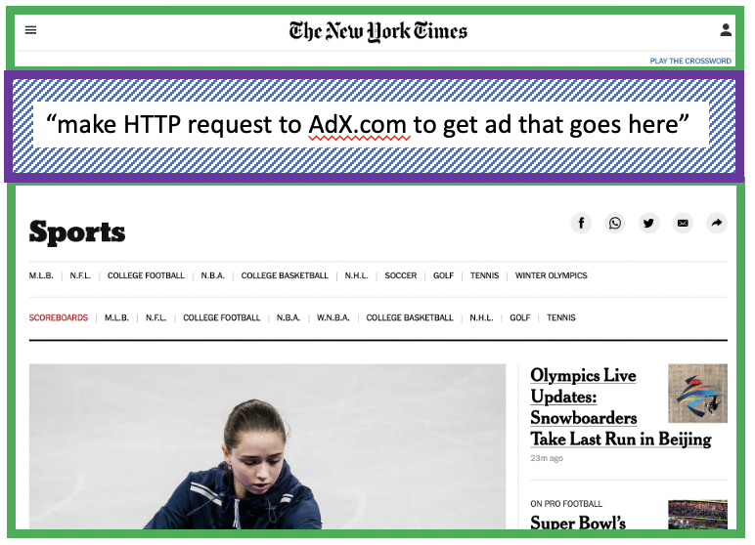
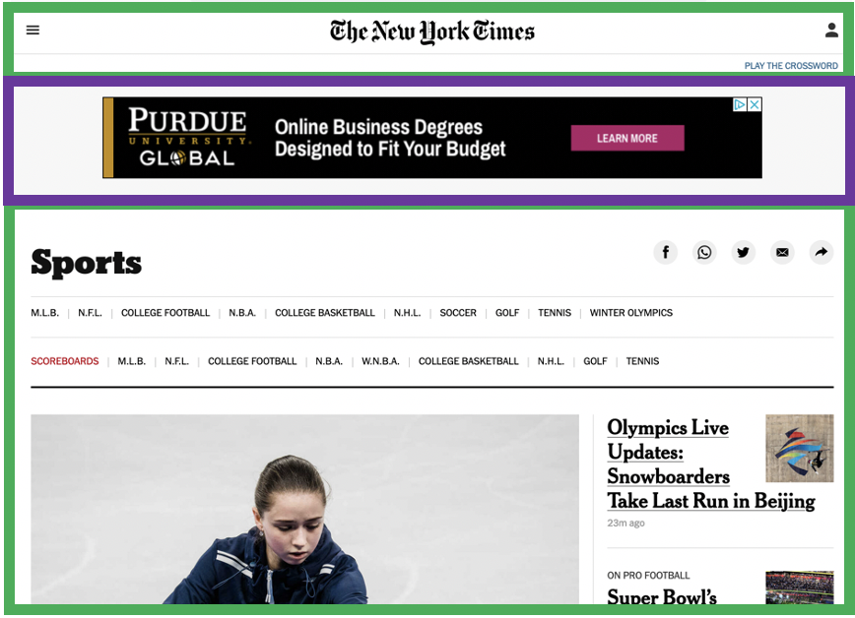


Example: displaying a NY Times web page
1
GET base html file from nytimes.com
2
fetch ad from AdX.com
nytimes.com
4
5
HTTP GET
1
2
HTTP reply
7
display composed page
3
4
6
5
NY times page with embedded ad displayed
AdX.com

Slide 36

Cookies: tracking a user’s browsing behavior
1634: sports, 2/15/22
nytimes.com (sports)
“first party” cookie – from website you chose to visit (provides base html file)
HTTP
GET
HTTP reply
Set cookie: 1634
HTTP GET
Referrer: NY Times Sports
4
5
7493: NY Times sports, 2/15/22
“third party” cookie – from website you did not choose to visit
HTTP reply
NY Times: 1634
Set cookie: 7493
AdX.com
AdX: 7493

Slide 37
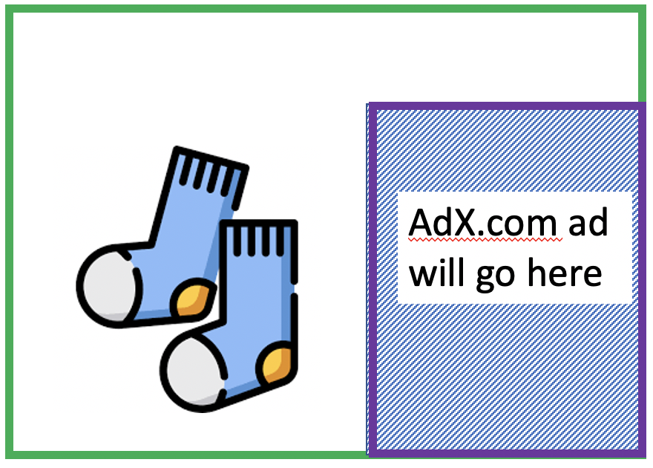
Cookies: tracking a user’s browsing behavior
1634: sports, 2/15/22
nytimes.com
AdX:
tracks my web browsing over sites with AdX ads
can return targeted ads based on browsing history
socks.com
HTTP reply
2
HTTP GET
1
HTTP GET
Referrer: socks.com, cookie: 7493
4
7493: NY Times sports, 2/15/22
5
7493: socks.com, 2/16/22
HTTP reply
NY Times: 1634
Set cookie: 7493
AdX.com
AdX: 7493

Slide 38

Cookies: tracking a user’s browsing behavior (one day later)
1634: sports, 2/15/22
1634: arts, 2/17/22
nytimes.com (arts)
socks.com
HTTP
GET
HTTP reply
cookie: 1634
Set cookie: 1634
HTTP GET
Referrer: nytimes.com, cookie: 7493
4
7493: NY Times sports, 2/15/22
5
7493: socks.com, 2/16/22
HTTP reply
7493: NY Times arts, 2/15/22
NY Times: 1634
Set cookie: 7493
AdX.com
AdX: 7493
Returned ad for socks!

Slide 39
Cookies: tracking a user’s browsing behavior
Cookies can be used to:
track user behavior on a given website (first party cookies)
track user behavior across multiple websites (third party cookies) without user ever choosing to visit tracker site (!)
tracking may be invisible to user:
rather than displayed ad triggering HTTP GET to tracker, could be an invisible link
third party tracking via cookies:
disabled by default in Firefox, Safari browsers
to be disabled in Chrome browser in 2023

Slide 40
References
Computer Networking: A Top-Down Approach
Chapter 2
TCP/IP Protocol Suite
Chapter 22
https://www.youtube.com/watch?v=h2kdEvquRY4
https://www.scaler.com/topics/persistent-connection-http/

Slide 41
Thank You

